Slide 1
Create instances on AWS

Slide 2
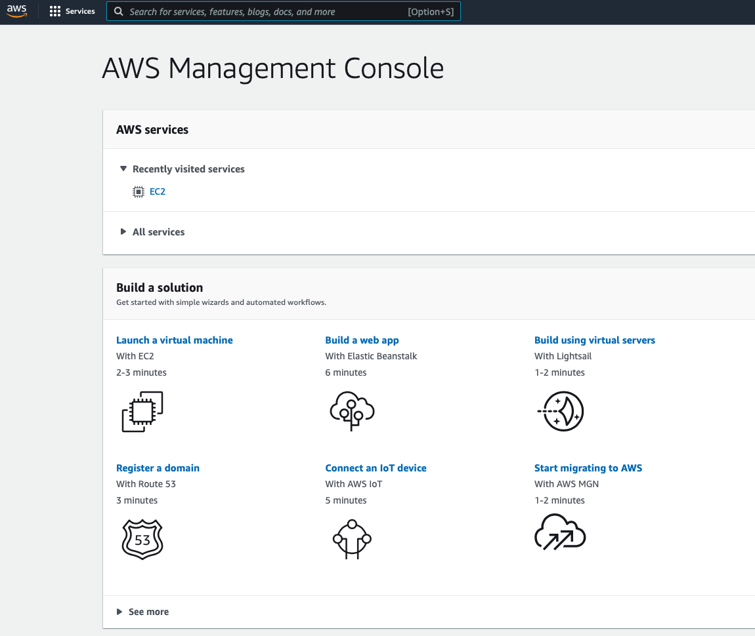

Slide 3
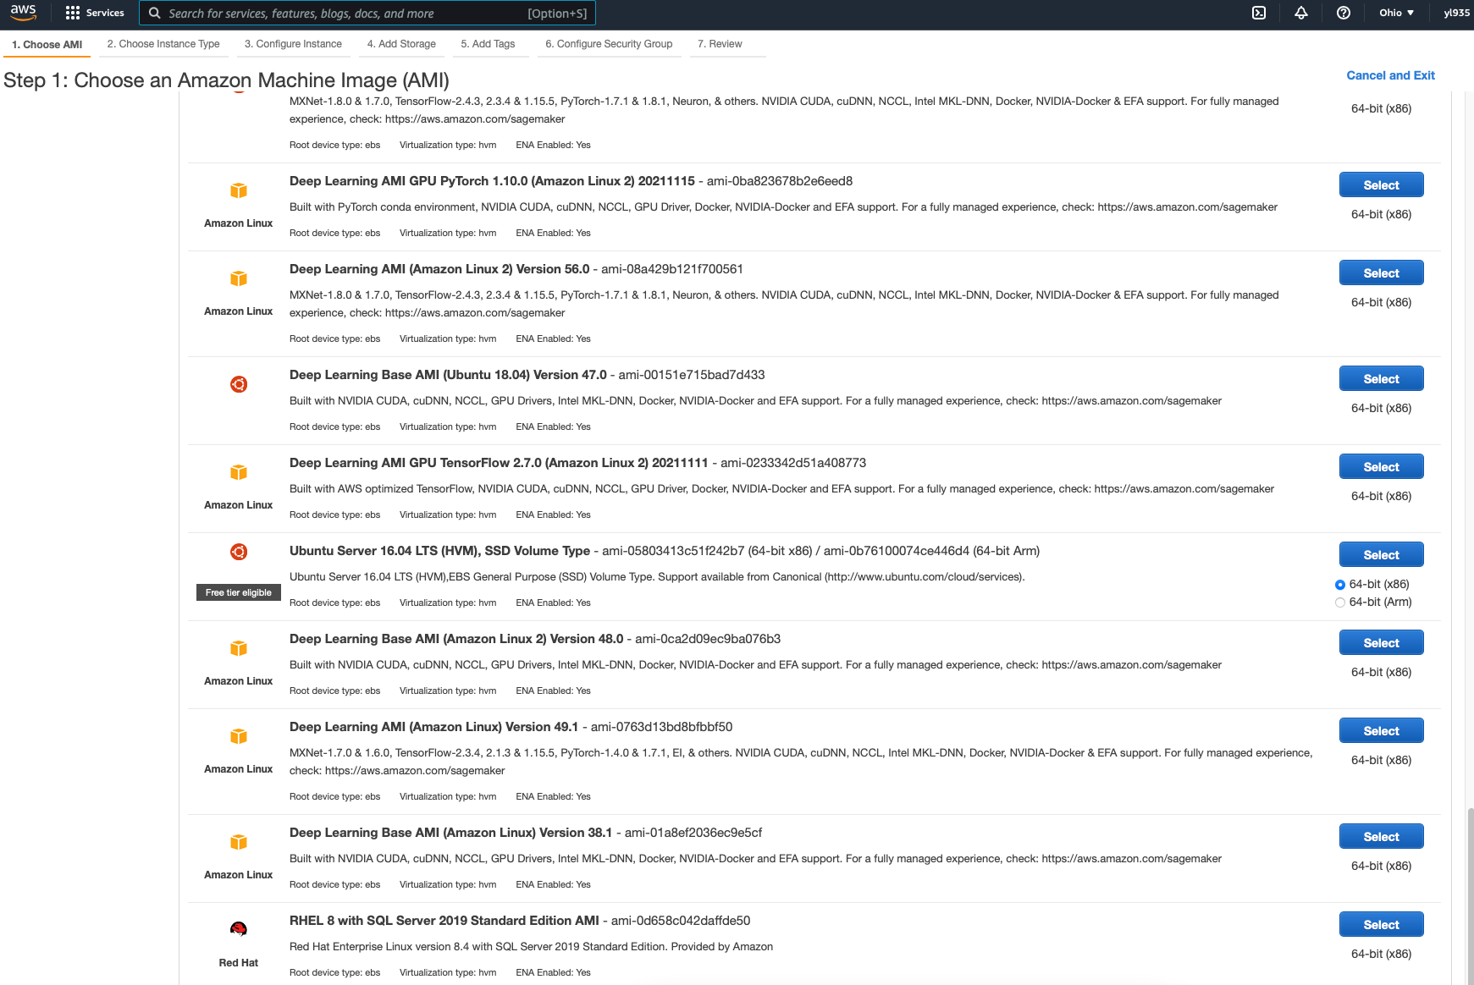

Slide 4
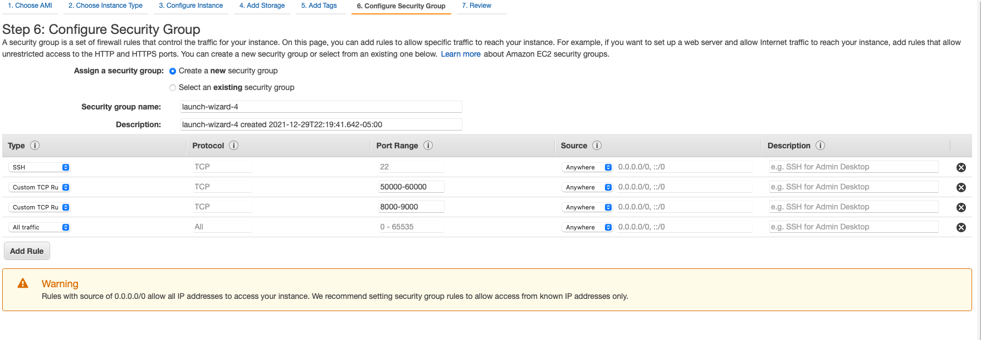
Step 3: 4 instances, allow access from sources: anywhere
https://docs.aws.amazon.com/AWSEC2/latest/UserGuide/security-group-rules-reference.html

Slide 5
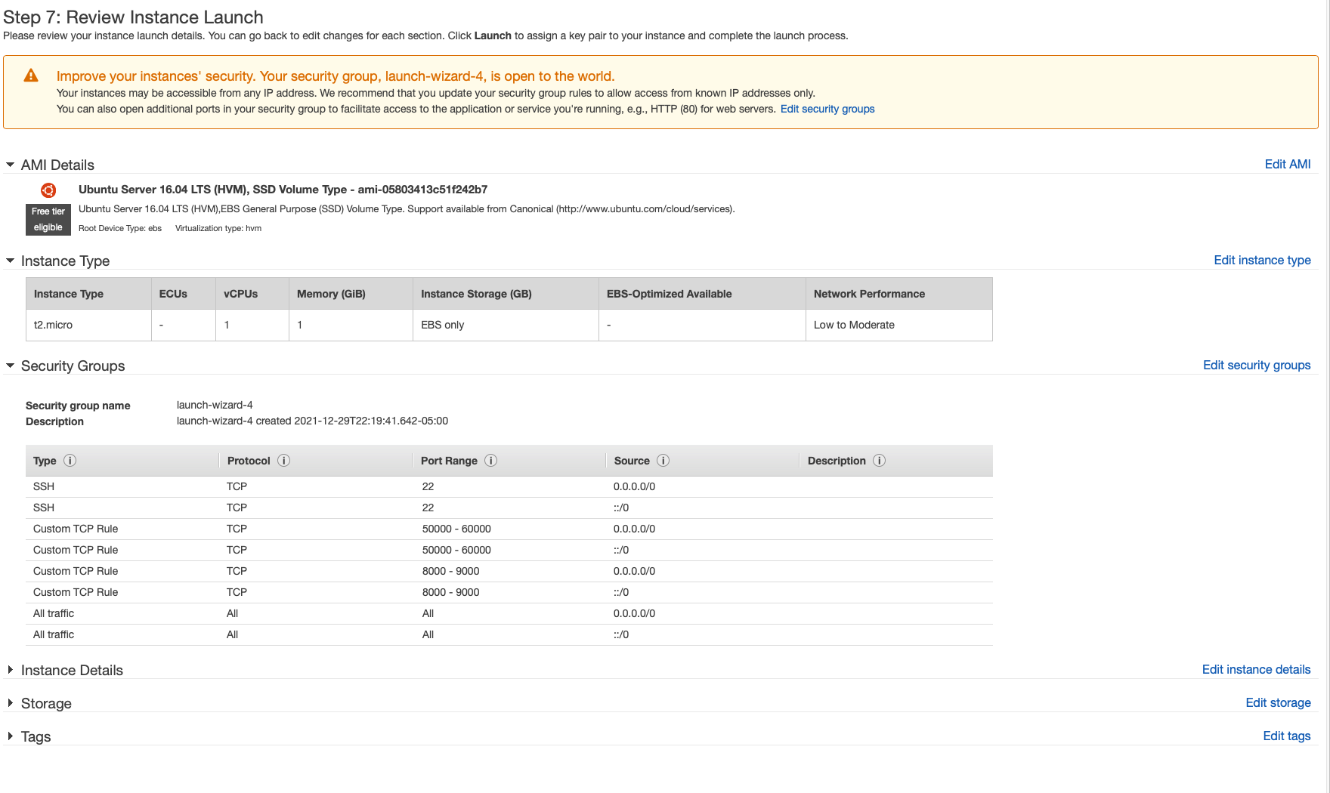

Slide 6
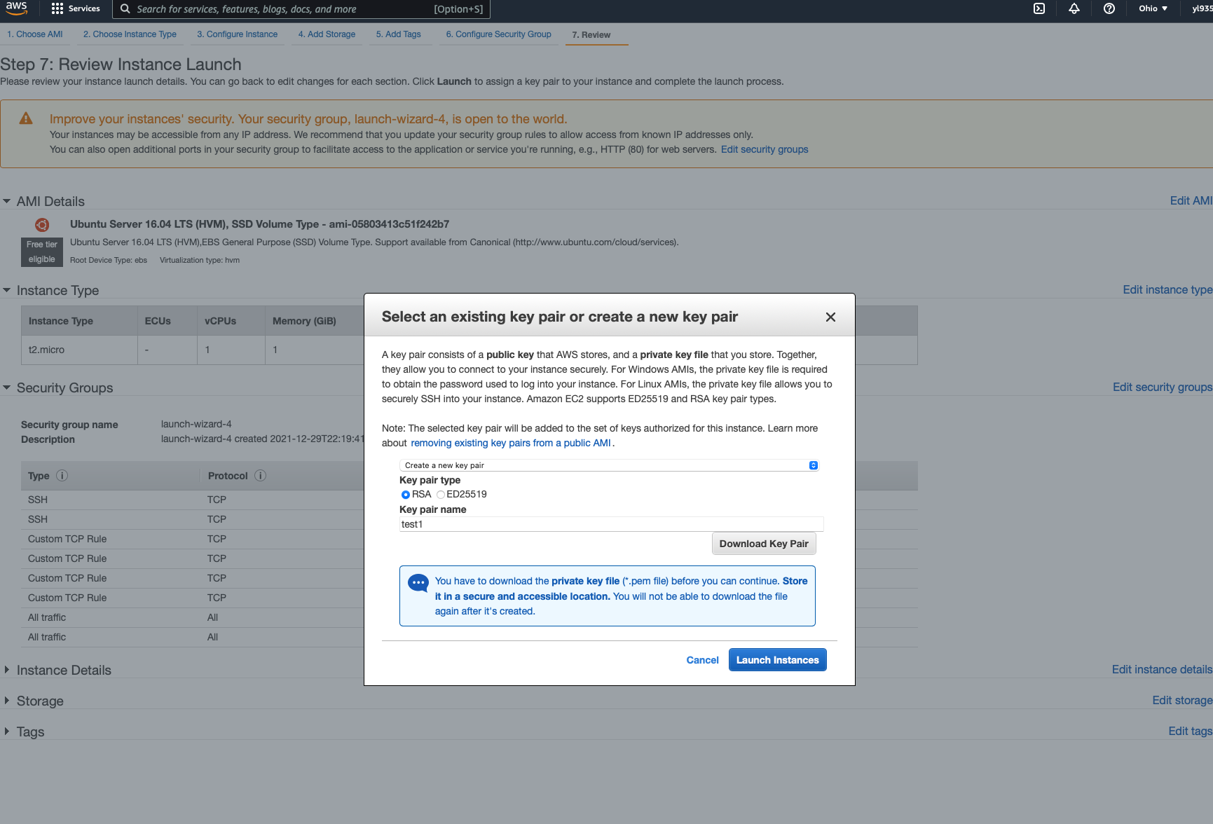

Slide 7
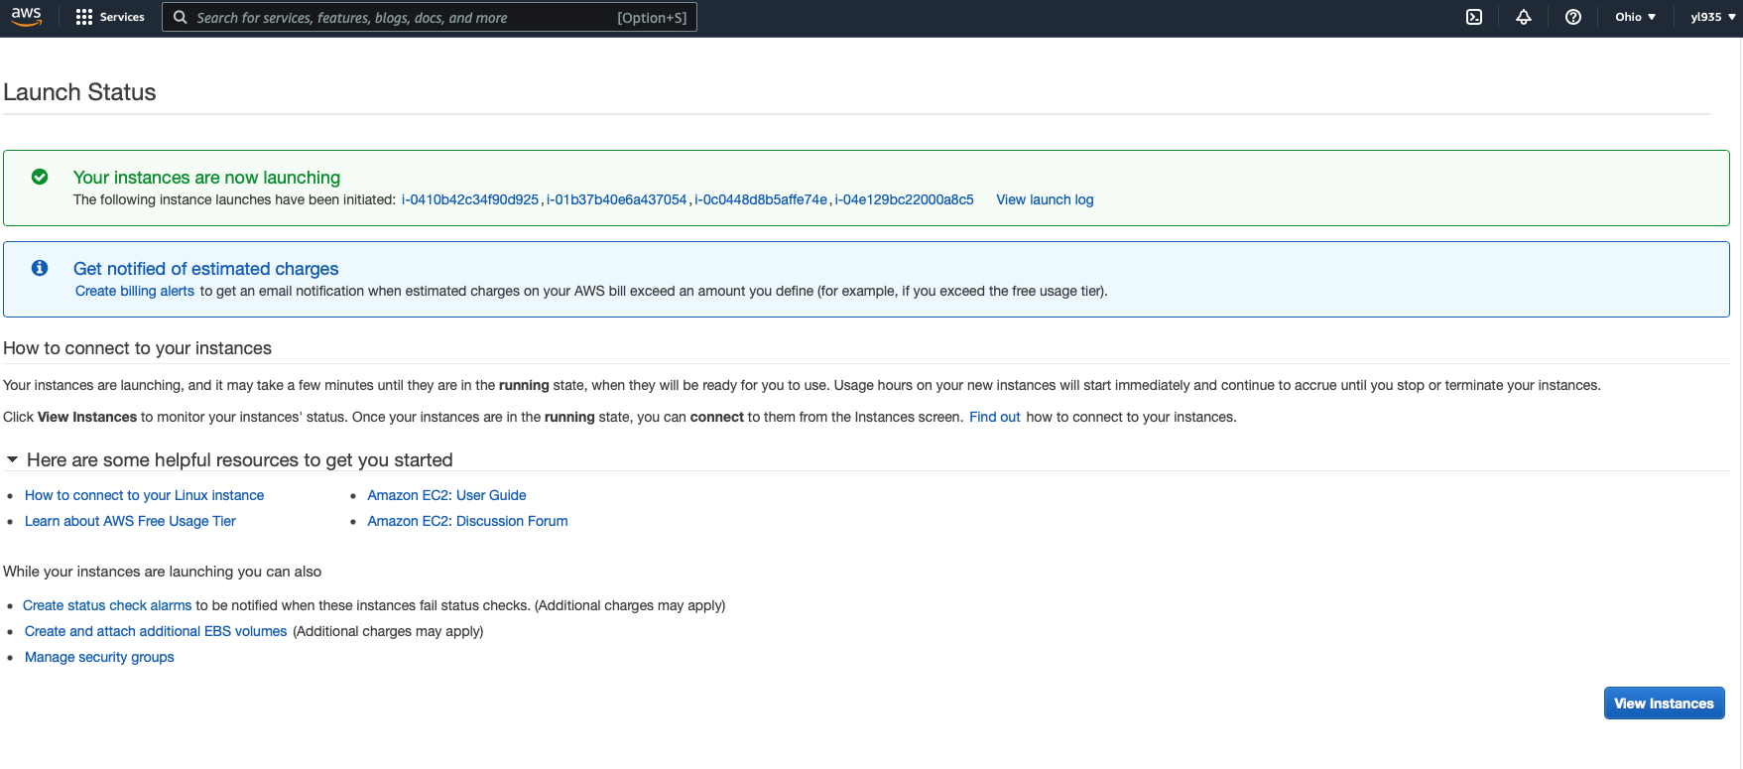

Slide 8
Hadoop Installation Fully Distributed Mode
Qianwen Ye

Slide 9
Before We Start
1. create a few VM instances (Ubuntu is suggested)
2. set proper security group constraints
3. allow passphraseless connection between them

Slide 10
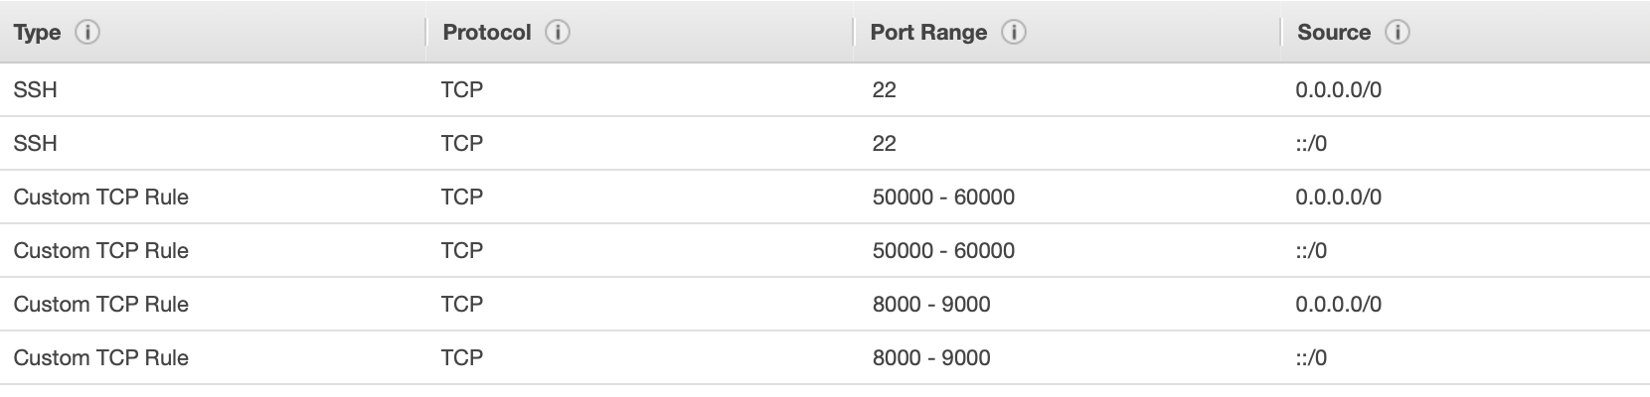
Security Group Snapshot
Inbound
Outbound

Slide 11
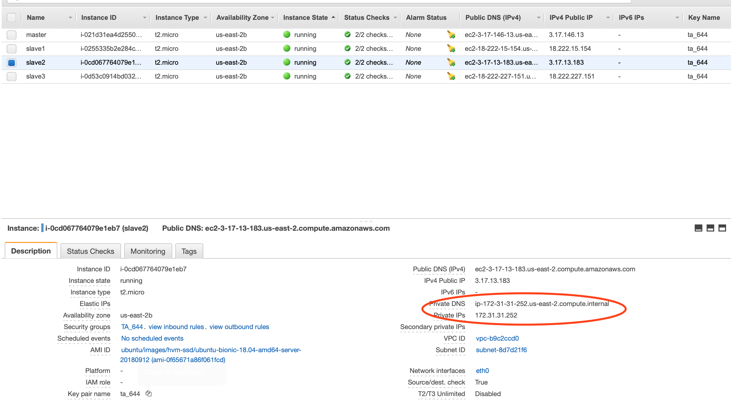
What I Have:
4 Ubuntu VMS in AWS
172.31.11.234
172.31.3.56
172.31.12.237
172.31.14.124
Already set up passphraseless ssh connection

Slide 12
Overview
Change /etc/hosts File (not necessary)
Java Installation
Hadoop Environment Configuration

Slide 13

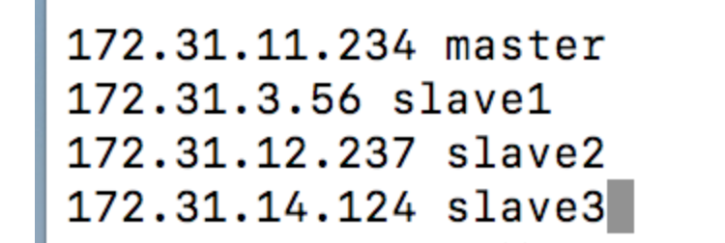
Change Hosts File
On each VM’s Terminal:
Add following content:

Slide 14




Change Hosts File
Then we can use the following command to connect to each other:

Slide 15


Install Java on each VM
Install Java.
Note that the default version changes, so you need to specify it to be java 8
Change the second command to: sudo apt install openjdk-8-jdk

Slide 16



Install Java on each VM
Configure JAVA HOME

Slide 17
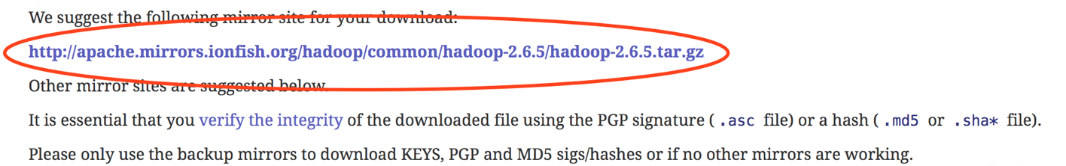
Download Hadoop: Master Node Only
Goes to Hadoop Download Page
http://hadoop.apache.org/releases.html
Find the link for downloading (binary)

Slide 18


Download Hadoop: Master Node Only
Download and unzip it, change the link in the command to this new link below:
https://archive.apache.org/dist/hadoop/common/hadoop-2.6.5/hadoop-2.6.5.tar.gz

Slide 19
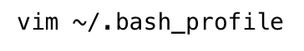
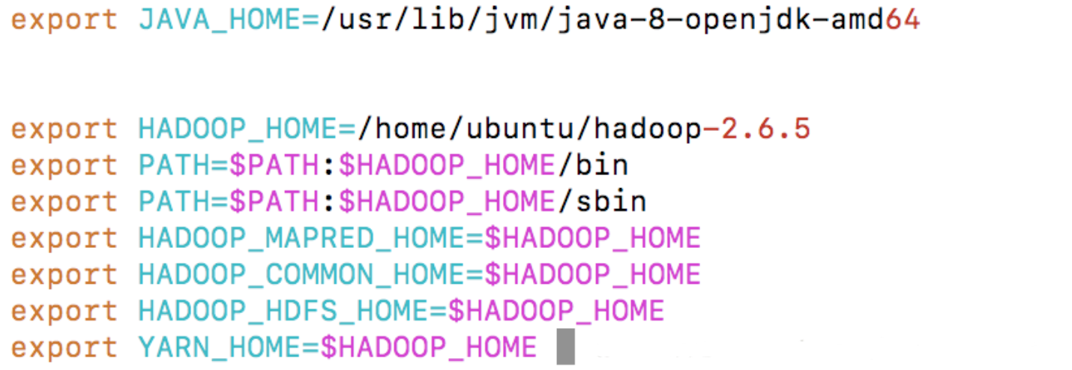

For all VMs: Configure ~/.bash_profile
Text you can copy:
export JAVA_HOME=/usr/lib/jvm/java-8-openjdk-amd64
export HADOOP_HOME=/home/ubuntu/hadoop-2.6.5
export PATH=$PATH:$HADOOP_HOME/bin
export PATH=$PATH:$HADOOP_HOME/sbin
export HADOOP_MAPRED_HOME=$HADOOP_HOME
export HADOOP_COMMON_HOME=$HADOOP_HOME
export HADOOP_HDFS_HOME=$HADOOP_HOME
export YARN_HOME=$HADOOP_HOME
Command to run the file: source ~/.bash_profile

Slide 20

Configure Hadoop: Master Node Only
Hadoop’s directory
Files need to be modified
core-site.xml, hdfs-site.xml, mapred-site.xml, yarn-site.xml
hadoop-env.sh
slaves, masters

Slide 21
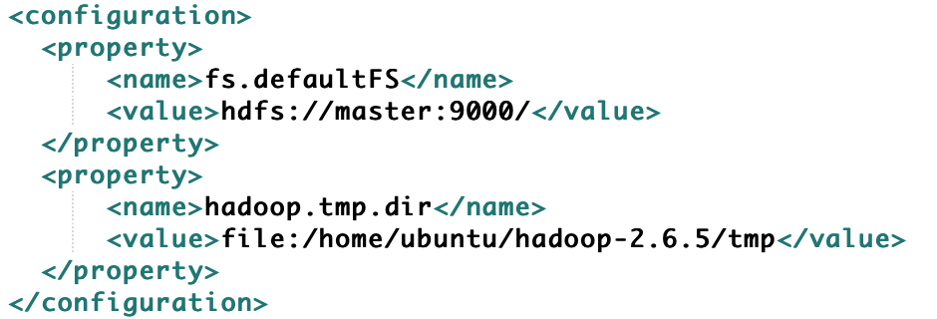
core-site.xml

Slide 22
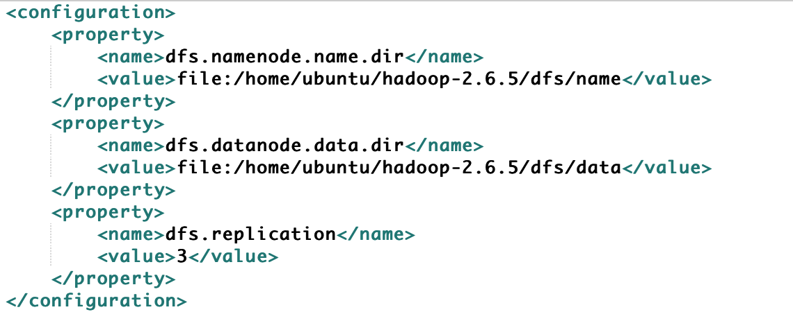
hdfs-site.xml

Slide 23
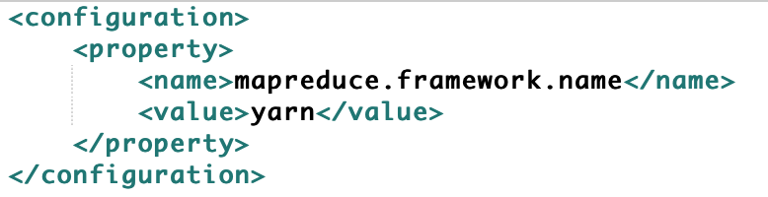
mapred-site.xml.template

Slide 24
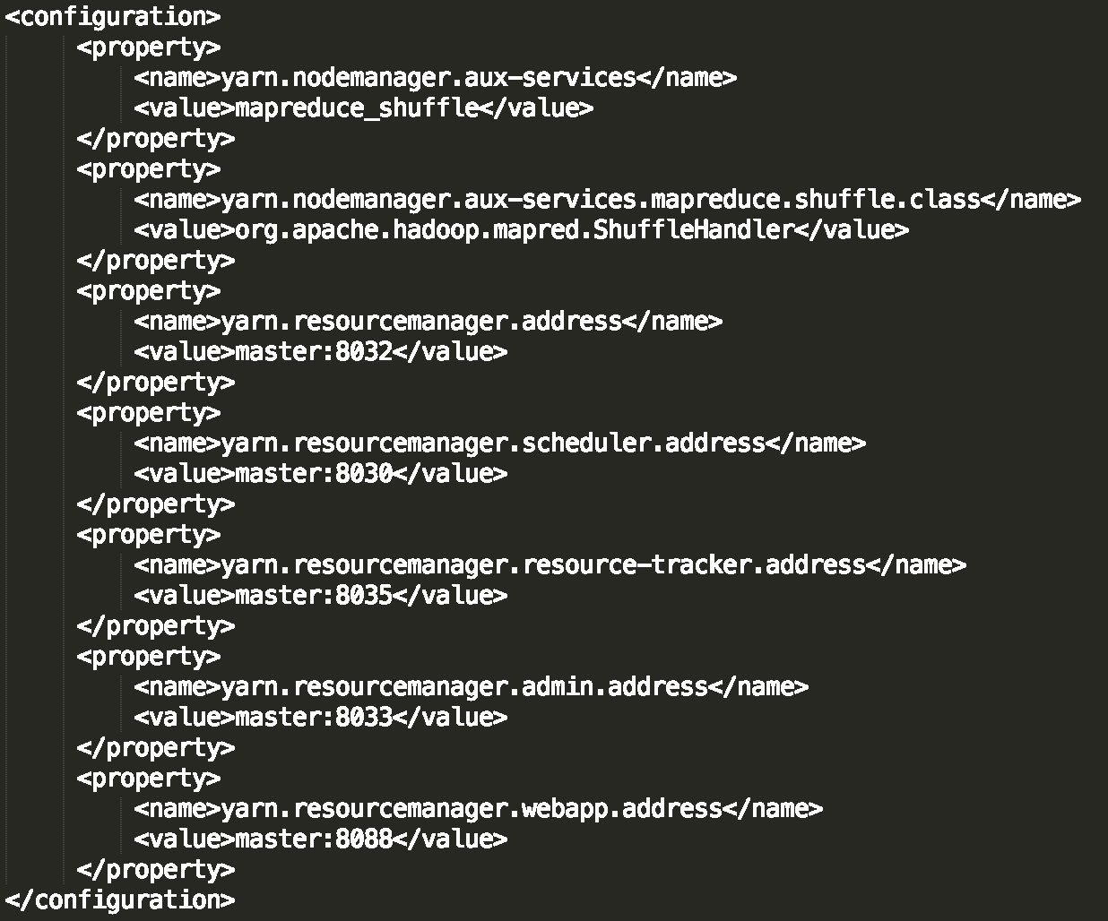
yarn-site.xml

Slide 25
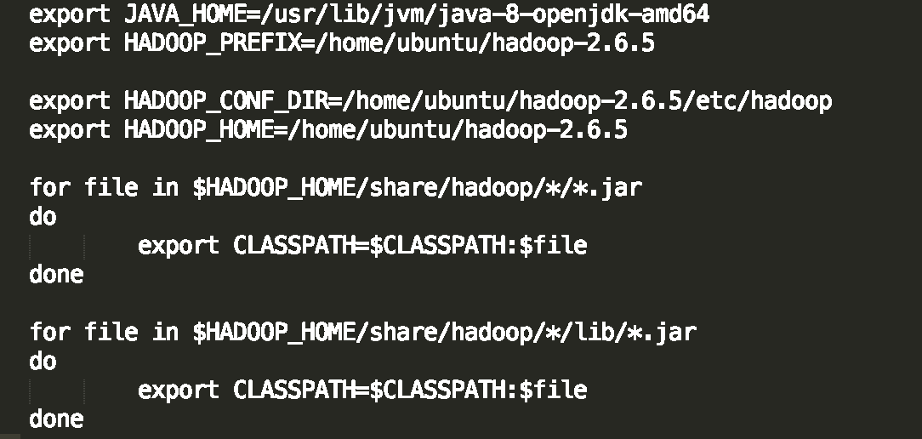

hadoop-env.sh

Slide 26
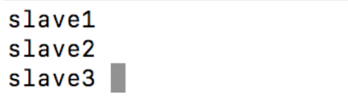
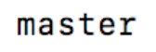
Masters and slaves
Slaves
Master
To be simple, on master node, just edit the slaves file to Include:
slave 1
slave 2
slave 3
Then, add one master file because it doesn’t have one.
To include:
master
You can delete the localhost if the file has it.
Later you will send Hadoop folder to other slave, so you don’t need to edit the slaves and master file again on other nodes.

Slide 27
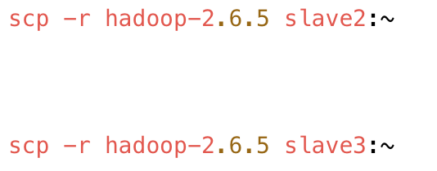
Send Hadoop to all other nodes

Slide 28

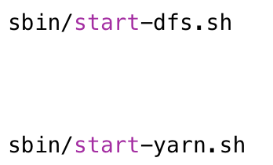
Format Namenode and Start Hadoop

Slide 29
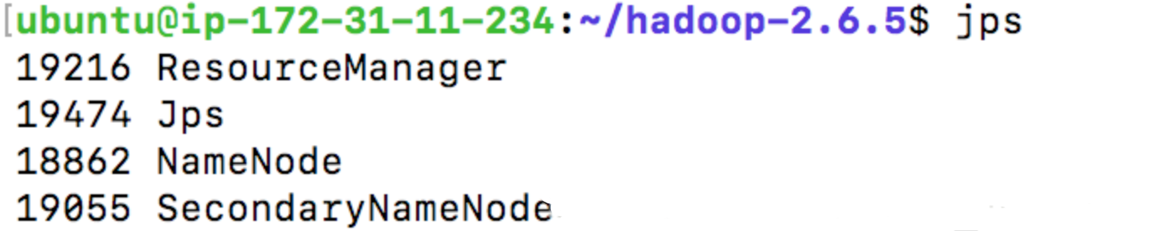
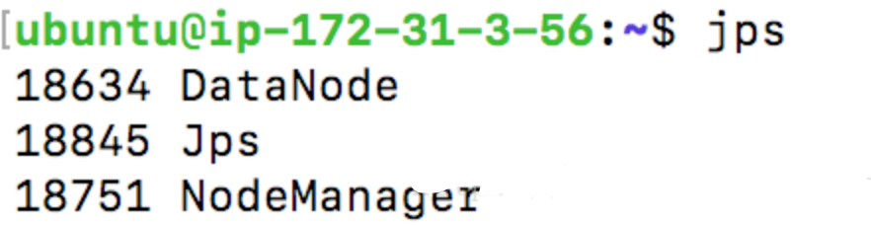
Processes on Master node and Slave node

Slide 30
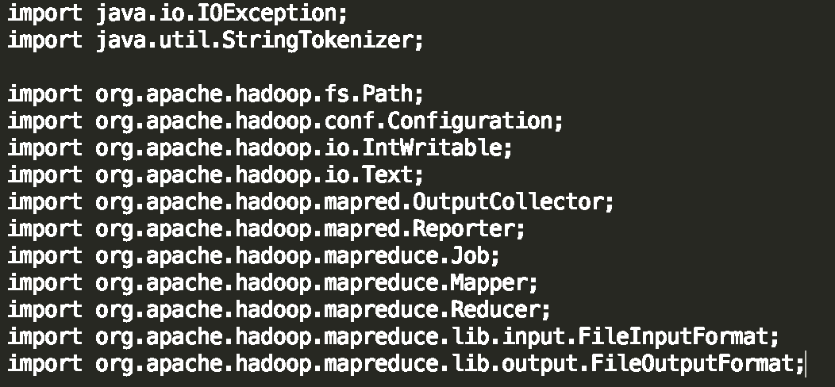
Example: WordCount

Slide 31
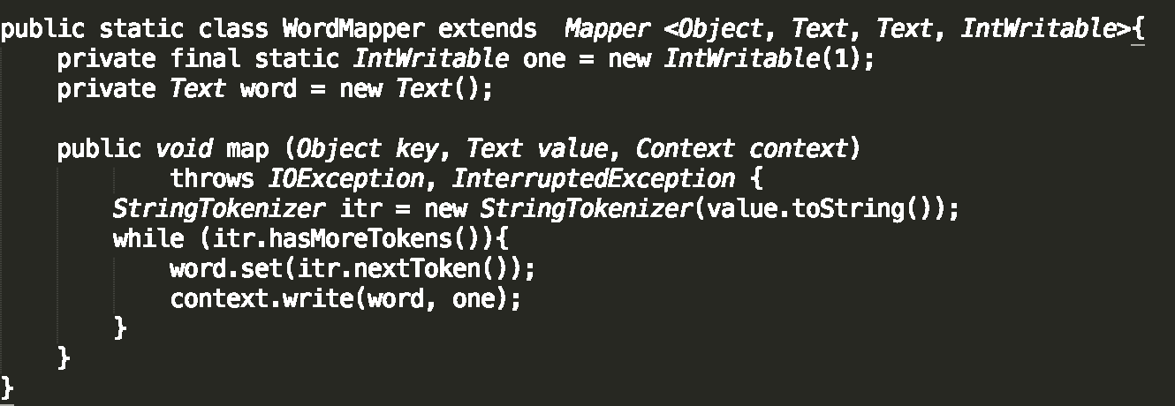
WordCount: Map

Slide 32
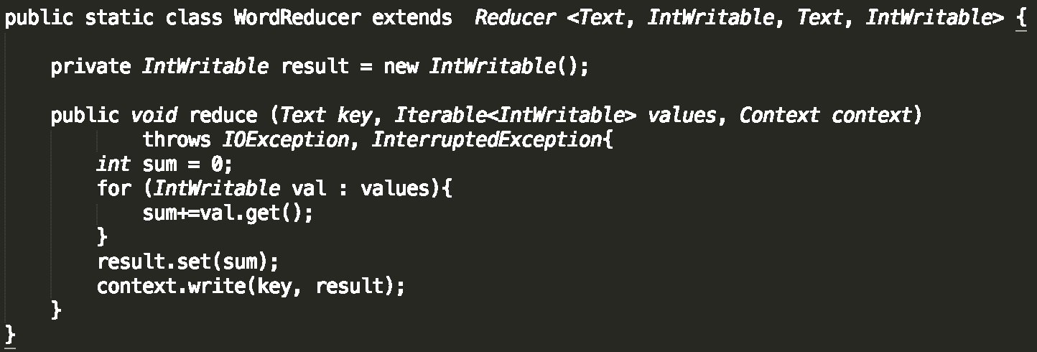
WordCount: Reduce

Slide 33
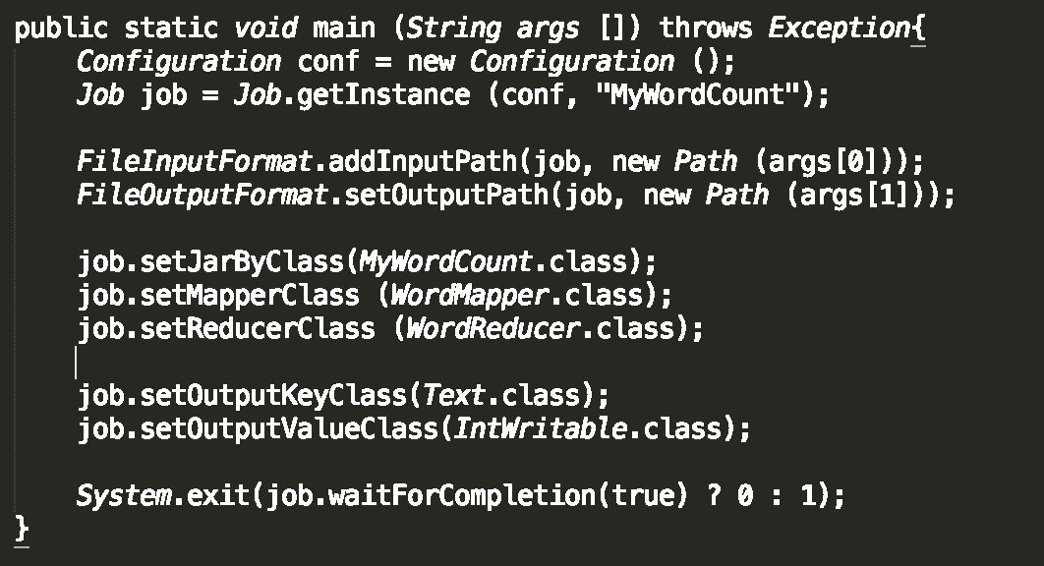
WordCount: Main

Slide 34


Compile WordCount and make jar package

Slide 35



Prepare Input

Slide 36
Execute WordCount Program

Slide 37

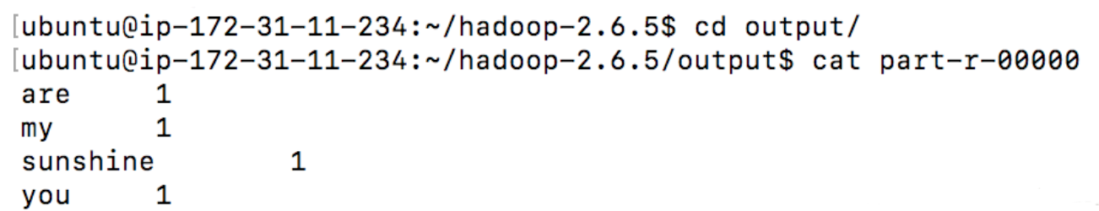
Check Result

Slide 38
Thank you!

